Slide 1
Bayesian Modeling

Slide 2
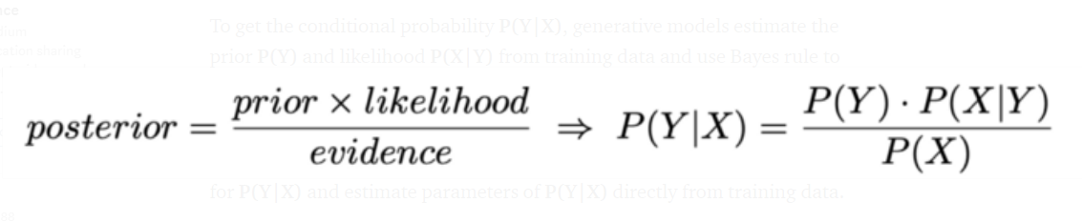
Baye’s Rule

Slide 3
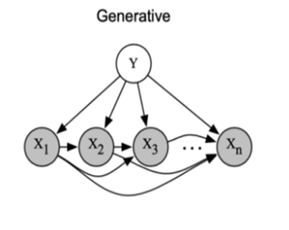
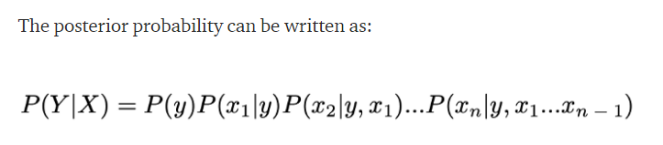
Baye’s Rule

Slide 4
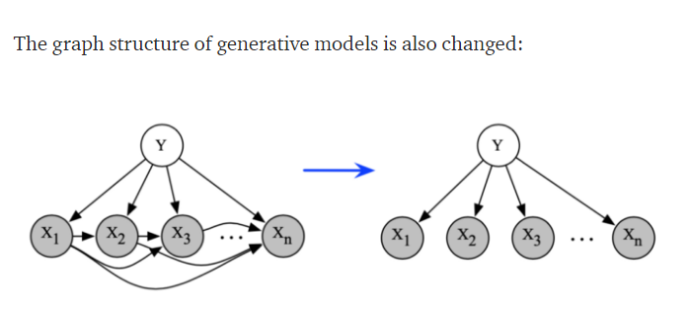
Naïve Bayes Model

Slide 5
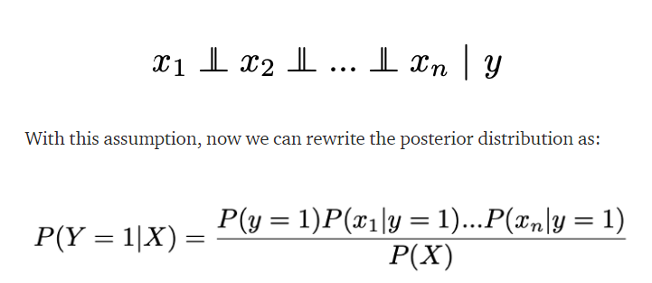
Naïve Bayes Model

Slide 6

The Bayes Classifier
A good strategy is to predict:
So … How do we compute that?

Slide 7
Why is this useful?
# of parameters for modeling P(X₁,…,X_{n}|Y):
  2(2^{n}-1)
# of parameters for modeling P(X₁|Y),…,P(X_{n}|Y)
  2n

Slide 8
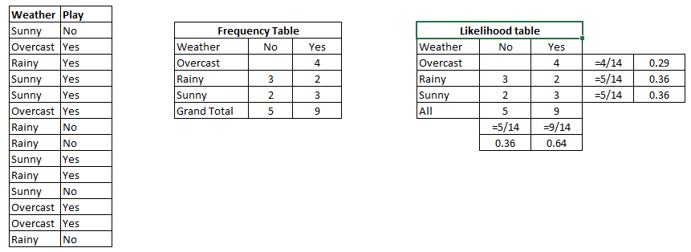
Naïve Bayes Example

Slide 9
Naïve Baye’s Example
P(Yes | Sunny) = P( Sunny | Yes) * P(Yes) / P (Sunny)
Here we have P (Sunny |Yes) = 3/9 = 0.33, P(Sunny) = 5/14 = 0.36, P( Yes)= 9/14 = 0.64
Now, P (Yes | Sunny) = 0.33 * 0.64 / 0.36 = 0.60, which has higher probability.

Slide 10

Example - 2
Example: Play Tennis

Slide 11
Example
Learning Phase
Outlook | Play=Yes | Play=No
Sunny | 2/9 | 3/5
Overcast | 4/9 | 0/5
Rain | 3/9 | 2/5
Temperature | Play=Yes | Play=No
Hot | 2/9 | 2/5
Mild | 4/9 | 2/5
Cool | 3/9 | 1/5
Humidity | Play=Yes | Play=No
High | 3/9 | 4/5
Normal | 6/9 | 1/5
Wind | Play=Yes | Play=No
Strong | 3/9 | 3/5
Weak | 6/9 | 2/5
P(Play=Yes) = 9/14
P(Play=No) = 5/14

Slide 12
Example
Test Phase
  Given a new instance,
  x’=(Outlook=Sunny, Temperature=Cool, Humidity=High, Wind=Strong)
  Look up tables
  MAP rule
P(Outlook=Sunny|Play=Yes) = 2/9
P(Temperature=Cool|Play=Yes) = 3/9
P(Huminity=High|Play=Yes) = 3/9
P(Wind=Strong|Play=Yes) = 3/9
P(Play=Yes) = 9/14
P(Outlook=Sunny|Play=No) = 3/5
P(Temperature=Cool|Play==No) = 1/5
P(Huminity=High|Play=No) = 4/5
P(Wind=Strong|Play=No) = 3/5
P(Play=No) = 5/14
P(Yes|x’): [P(Sunny|Yes)P(Cool|Yes)P(High|Yes)P(Strong|Yes)]P(Play=Yes) = 0.0053
P(No|x’): [P(Sunny|No) P(Cool|No)P(High|No)P(Strong|No)]P(Play=No) = 0.0206
Given the fact P(Yes|x’) < P(No|x’), we label x’ to be “No”.

Slide 13
Applications of Naïve Bayes
Spam Classification
  Given an email, predict whether it is spam or not
Medical Diagnosis
  Given a list of symptoms, predict whether a patient has disease X or not
Weather
  Based on temperature, humidity, etc… predict if it will rain tomorrow

Slide 14
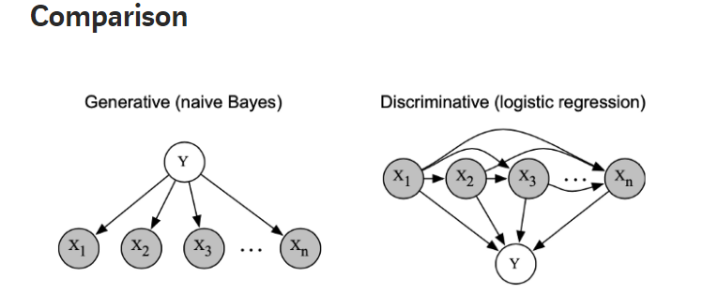
Comparison of Naïve Bayes with Logistic Regression

Slide 15
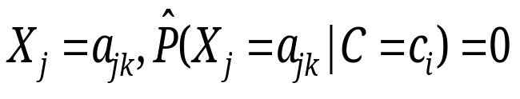
Limitations of Naïve Bayes model
Violation of Independence Assumption
  For many real world tasks the features are dependent
Zero conditional probability Problem
  If no example contains the attribute value

Slide 16
BAYESIAN NETWORK

Slide 17
Joint Probability of all features
# of parameters for modeling P(X₁,…,X_{n}|Y):
  2(2^{n}-1)

Slide 18
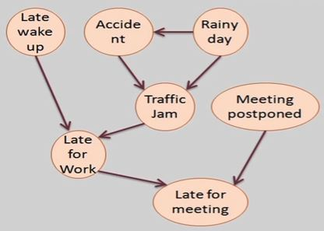
Structure of Bayesian Network

Slide 19
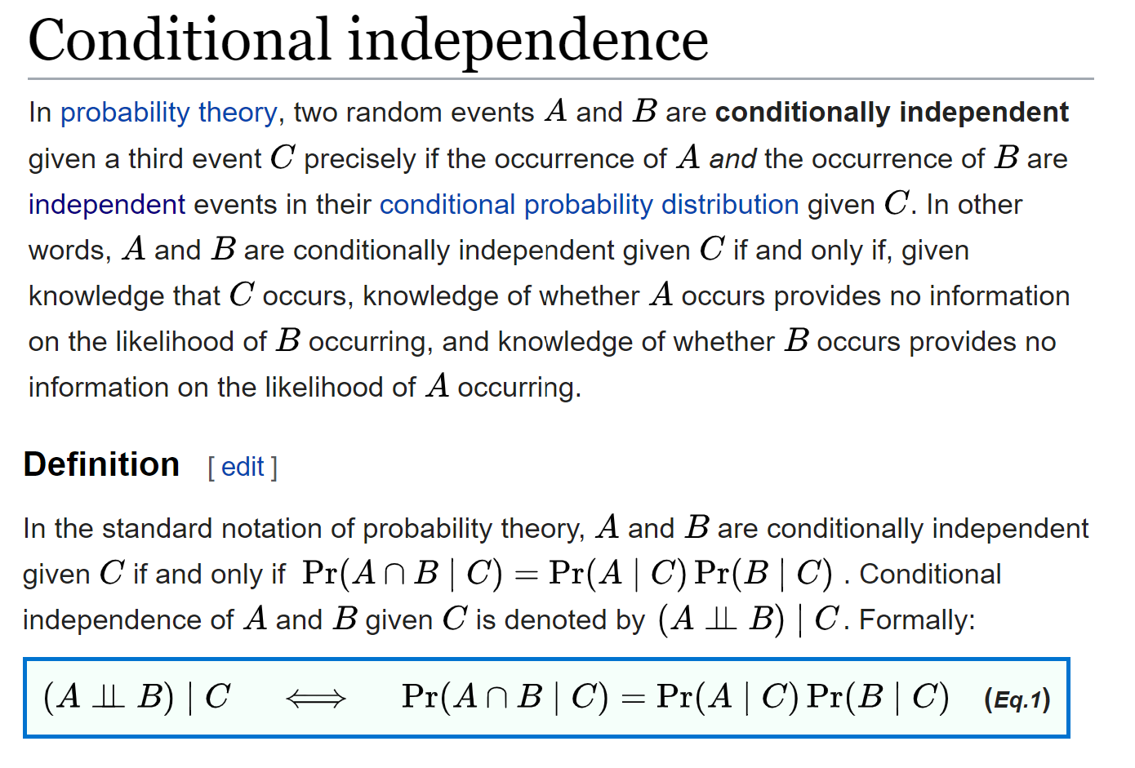
Arc – Relationship in Bayesian network
Independence
Conditionally independent
Causal relationship

Slide 20
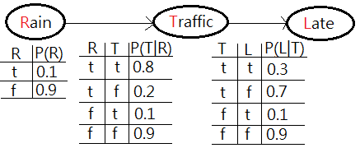
Conditional Probability Distribution Table

Slide 21
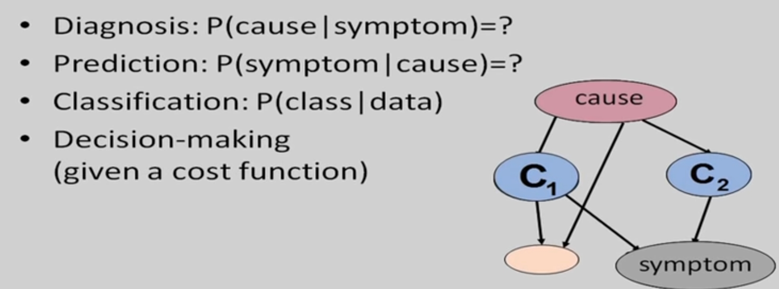
Applications of Bayesian Network

Slide 22
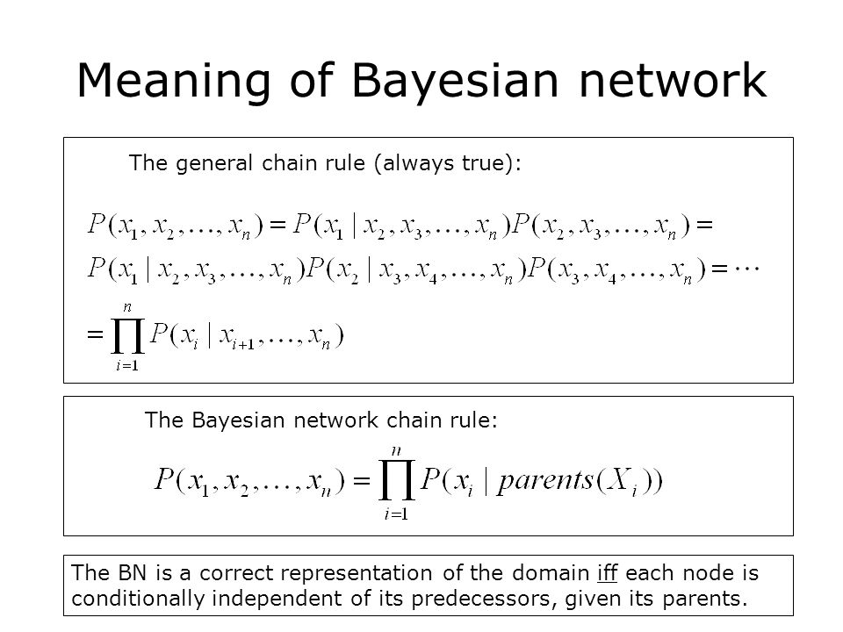
Inference in Bayesian Network

Slide 23
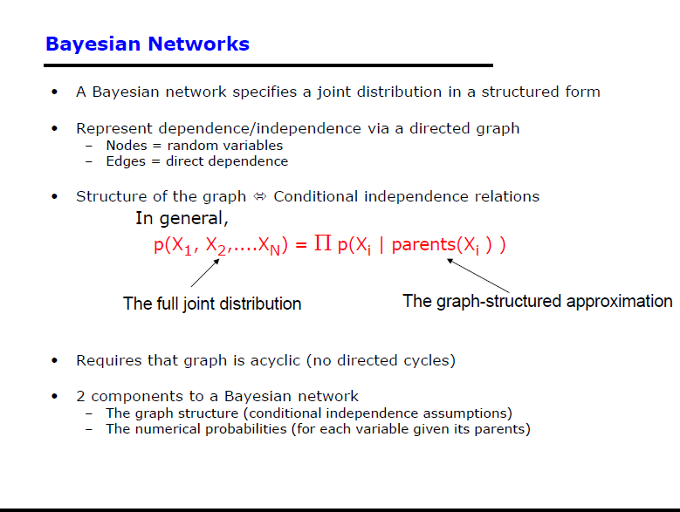

Slide 24
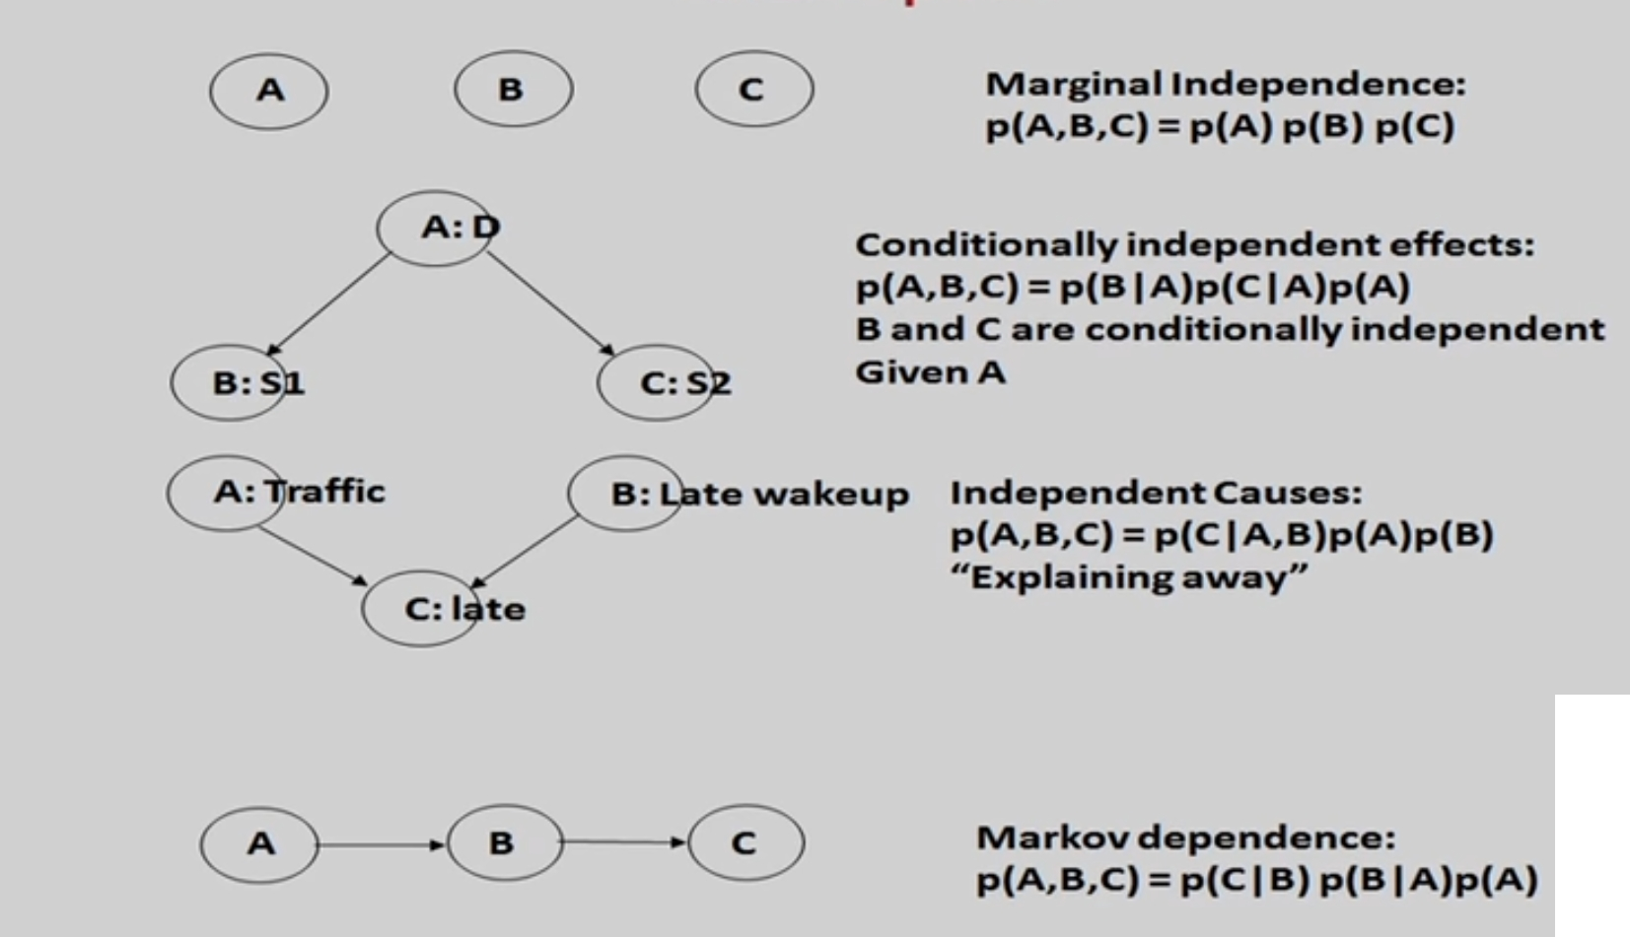
Possible structure in BN

Slide 25
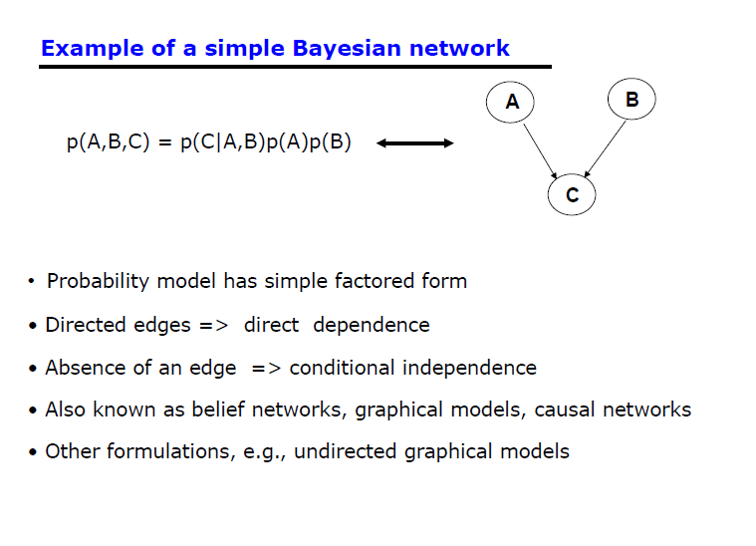

Slide 26
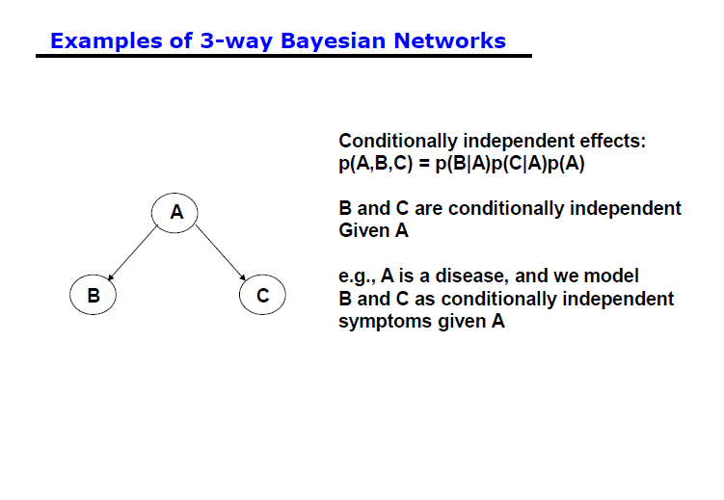

Slide 27
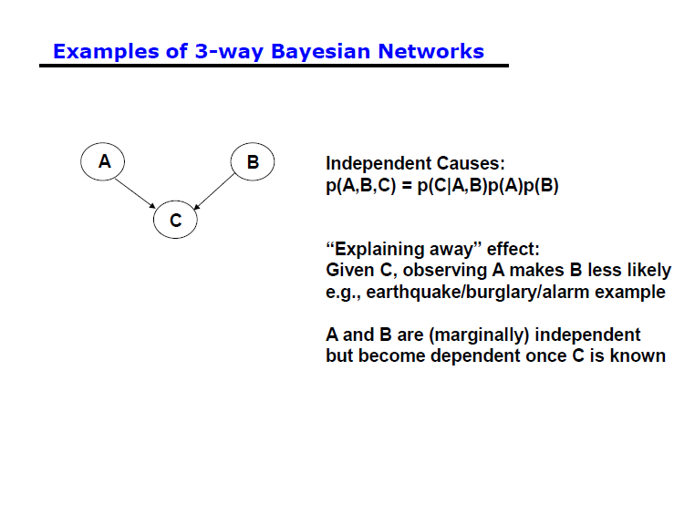

Slide 28
Possibilities of Bayesian Network
Structure known and CPT known
Structure known and few CPT known
Structure to be learned

Slide 29
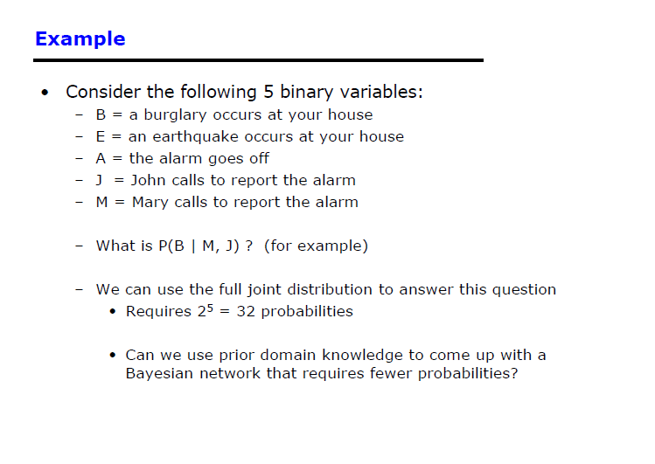

Slide 30
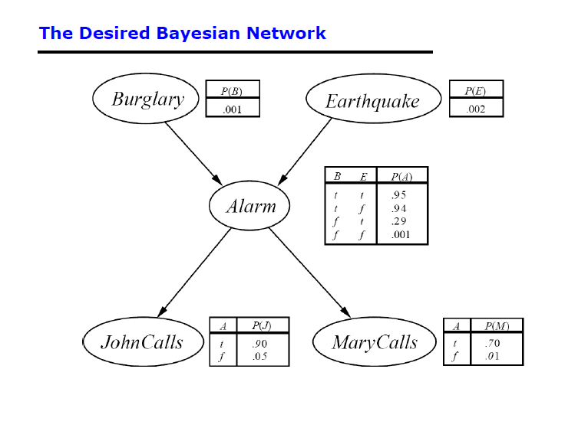

Slide 31
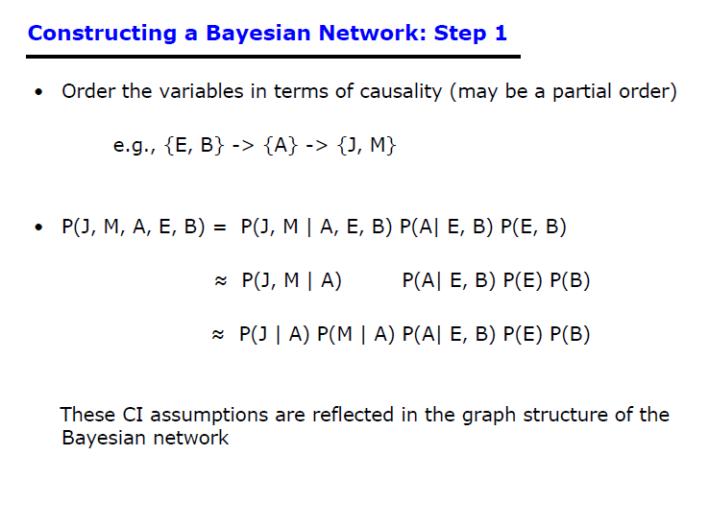

Slide 32
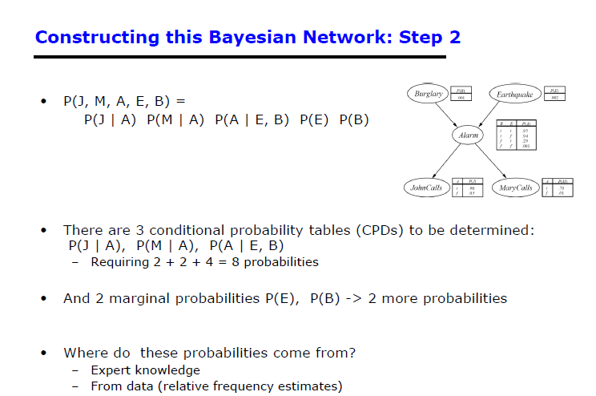

Slide 33
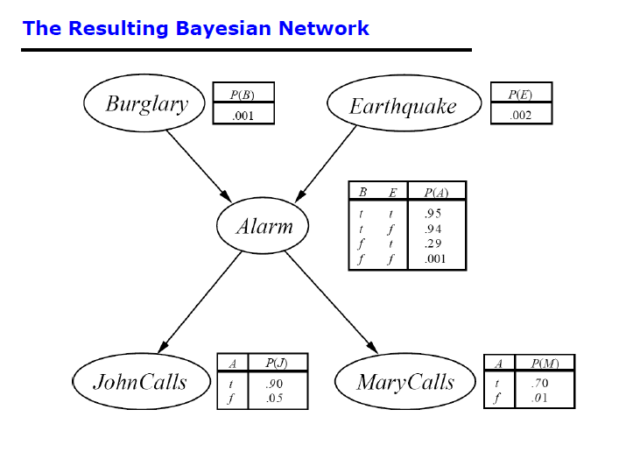

Slide 34
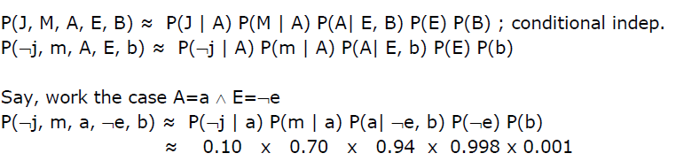
Example

Slide 35
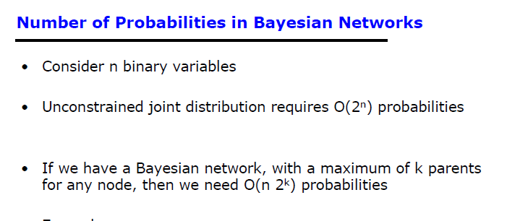

Slide 36
Further understanding Bayesian data modeling
https://www.youtube.com/watch?v=3OJEae7Qb_o
https://www.youtube.com/watch?v=mAUwjSo5TJE
https://www.youtube.com/watch?v=Ie-6H_r7I5A

